Slide 1
Phone Mic Live!
Submitted by
SOUHAM BISWAS
B.Tech CSE VIth Sem.

Slide 2
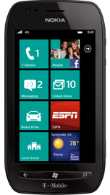
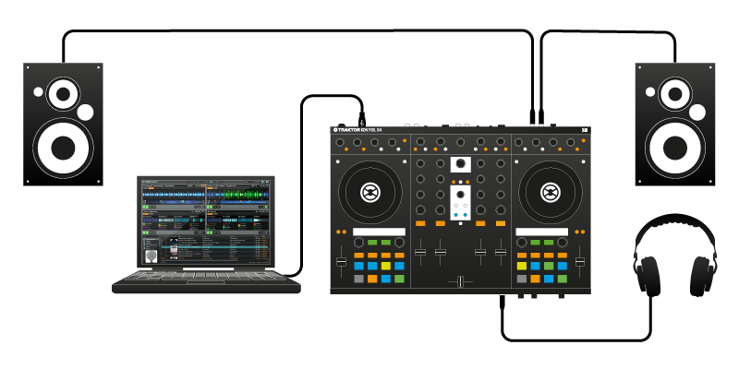

Software Overview -
This application transforms an ordinary Windows Phone into a full fledged wireless microphone.
SOUND STREAMED WIRELESSLY OVER WiFi
SOUND PLAYED BACK THROUGH AUDIO EQUIPMENT CONNECTED TO SYSTEM

Slide 3
This involves an app running on the phone, and an app running on the system connected to the speakers.
An ad-hoc WiFi network hotspot is established by the app on the system to which the phone connects. A live TCP connection is maintained between the phone and the system over which all the audio entering the phone is streamed to the system and played by the speaker system in real-time.

Slide 4
Application Features
Large Wireless Range –
Most wireless mics don’t have a range beyond 10 meters. But since this is dependent on the WiFi radio, which usually extends much beyond 10 meters, hence gives a huge range bonus over conventional wireless microphone systems.
Mobility and versatility –
The Windows Phone application is scalable across all Windows Phone devices, which allows it to run on any Windows Phone device. Moreover, it can be easily ported to other platforms like Android, using the Mono (Xamarin) framework, as this is written in C# language.

Slide 5
Compatibility across Windows Platforms –
The server side application was developed in the C# programming language which was developed by Microsoft, and requires a minimum of .NET 4.0 runtime to run. Now since most Windows Operating systems are already shipped with .NET 4.0 Framework, hence it renders the server application compatible across most Windows platforms.
Cheap and powerful alternative –
This can be easily used in place of an actual wireless mic system at no extra cost. Hence, it is pretty much a cheap and powerful alternative.

Slide 6
Software Pre-requisites -
.NET Runtime 4.0 (on server side)
The application has been developed in C#.
The fact that it is .NET 4.0 based allows it to run on most Windows based machines, as .NET 4.0 is shipped by default alongwith all Windows Operating Systems.
WiFi hardware (on server side)
The audio captured by the phone is streamed over a live link maintained between the phone and the target system via the WiFi radio hardware.
Windows Phone OS 7.1 (on phone)
The phone side application has been developed for the Windows Phone 7.1 Mango OS Environment.
The phone application runs in a .NET CF(Compact Framework) environment, which is a stripped version of the original .NET framework optimized for devices with memory and computational constraints.

Slide 7
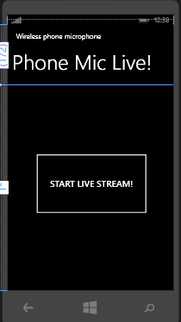
Software Workings-
Phone Application-

Slide 8
Upon tapping the “START LIVE STREAM!” button, the phone starts to stream audio incident on it’s microphone over the wireless link to the target system.
The audio is captured in raw PCM (Pulse Code Modulated) format, and is parsed into byte arrays which are stored temporarily.
The audio is captured into buffers which store audio information upto 100 ms, and then are serially transmitted in packets as raw PCM data to the server system

Slide 9
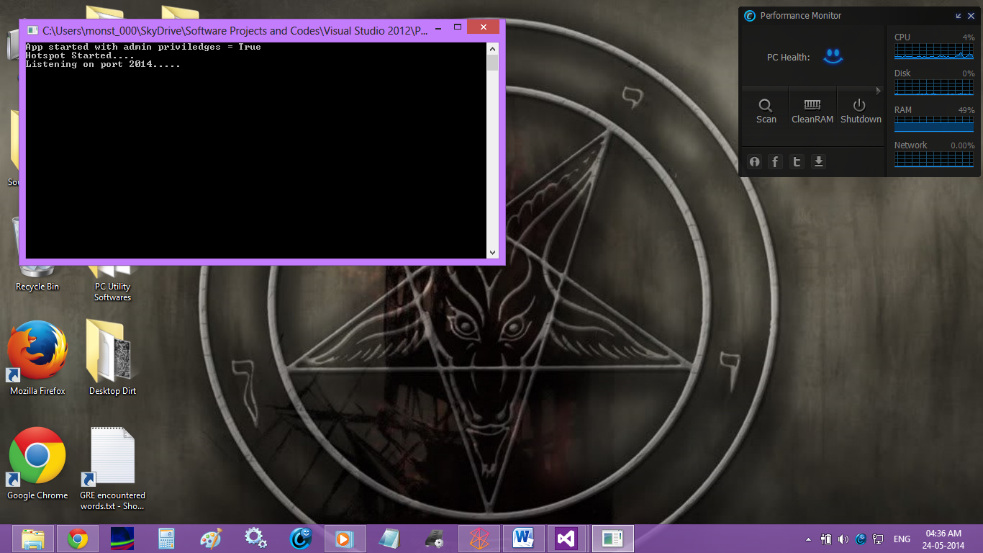
PC Side Application

Slide 10
The server side application is basically a console application which initializes a WiFi ad-hoc network hotspot to which the phone connects and streams the audio.
This is done by automatically passing commands to the native command prompt tool in Windows Operating Systems.
Once the network is up, the application starts to listen for incoming audio packets over port 2014.
As and when a packet is received, it is immediately played back in it’s raw, PCM format. This has been achieved with the help of the NAudio Library.

Slide 11
Custom Classes -
TCPDataExchange-
This abstract base class contains the basic TCP functionality parameters which is instrumental to both data receiving and sending activities.
TCPDataReader
This class encapsulates application logic pertaining to reading/receiving data over a TCP connection. This class inherits the TCPDataExchange class.

Slide 12
Custom Classes-
TCPDataSender
This class encapsulates application logic pertaining to sending data over a TCP connection. This class inherits the TCPDataExchange class.

Slide 13
Expansion Scope-
The server side application can be made into a nice GUI, and the overall application maybe expanded to allow for recording, storing and adding digital effects to incoming audio.
Moreover, a wireless camera application may be built on this framework.

Slide 14
Development Softwares Used -
Visual Studio 2012-
Visual Studio Software is a comprehensive software development IDE from Microsoft which allows for software development for any windows based platform in various languages.
Since this application is .NET based, hence this IDE was utilised. This IDE is also the only IDE to support building, and live debugging of Windows Phone Apps on real devices.

Slide 15
Bibliography
www.stackoverflow.com
www.codeproject.com
www.dreamincode.com
www.msdn.microsoft.com

